Slide 1
Einführung in Qgis Workshop 2022
Andreas Schönberg M.Sc.

Slide 2
Qgis Workshop – (3) Project World Map
Thema
(1) Einführung: Was sind Karten ?
(2) Projektionen, Verzerrungen, Geodäsie
(3) Project World Map: Datenmanagement, Datenaquise, Verarbeitung von Vector- und Rasterdaten, Druck Layout.

Slide 3

Qgis Workshop – (3) Project World Map
GIS
Jagt Dr. NO-ArcGIS

Slide 4

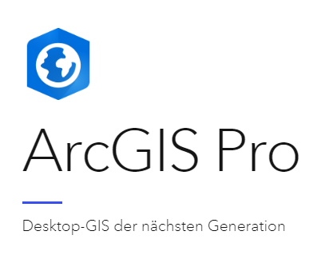



Qgis Workshop – (3) Project World Map
GeoInformationsSystem (GIS) Software
ArcMap | Qgis
Kostenpflichtige Lizenz | Open Source
Direkter Support | Support in der Community
Hohe Zuverlässigkeit | Freie Plugins
Anspruchsvolle Bedienung | Benutzerfreundlich
Implementierte Tools | Weitere Software
Stark für Netwerkanalyse | Stark in Kartendesign
(Firmenlogos entnommen der Webseiten)

Slide 5
Qgis Workshop – (3) Project World Map
Are we ready now to start with GIS ?
Learning by doing a WorldMap
First Things First – Data Management
Get your Data
Now we start with GIS
And make a World Map

Slide 6
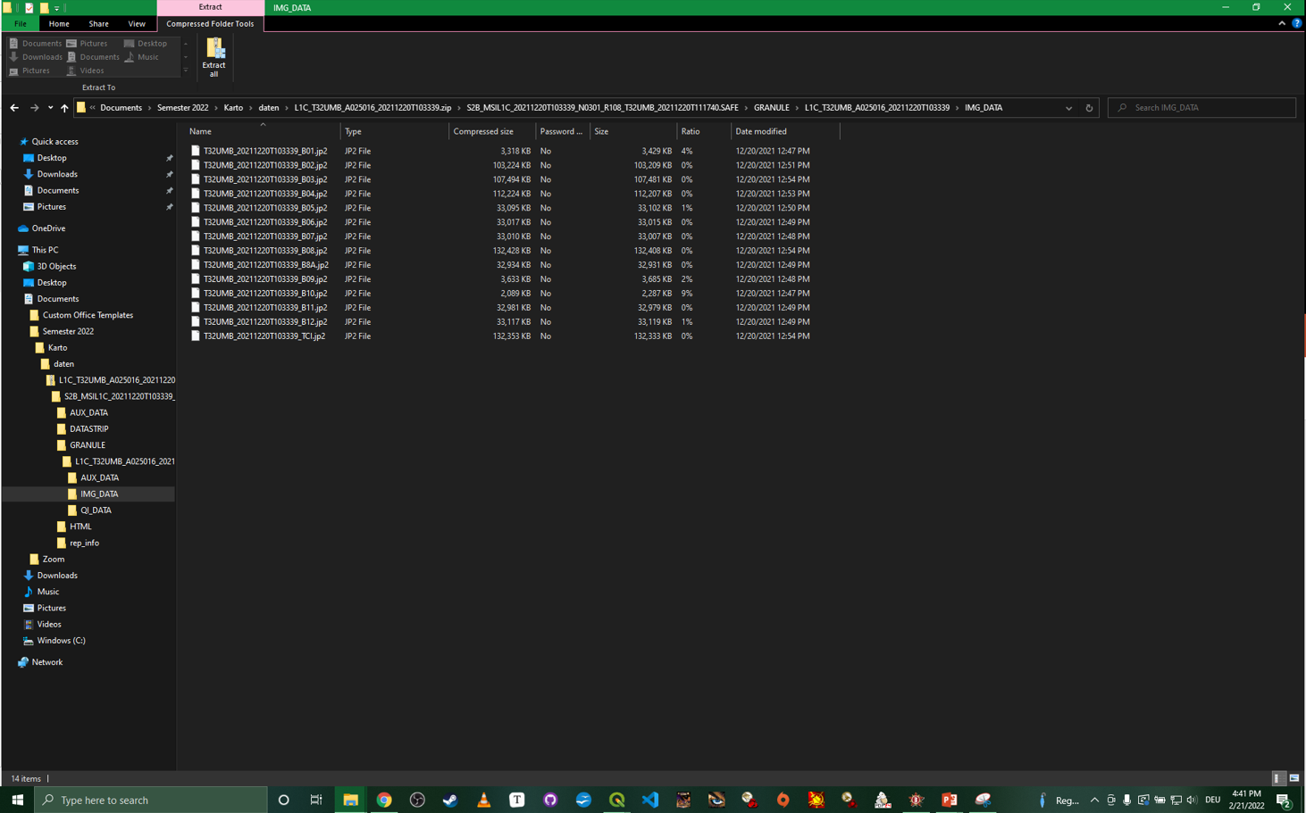
Qgis Workshop – (3) Project World Map
First Things First - Datamanagement
„Documents“ Folder
Complex and deep paths
Cryptic names

Slide 7
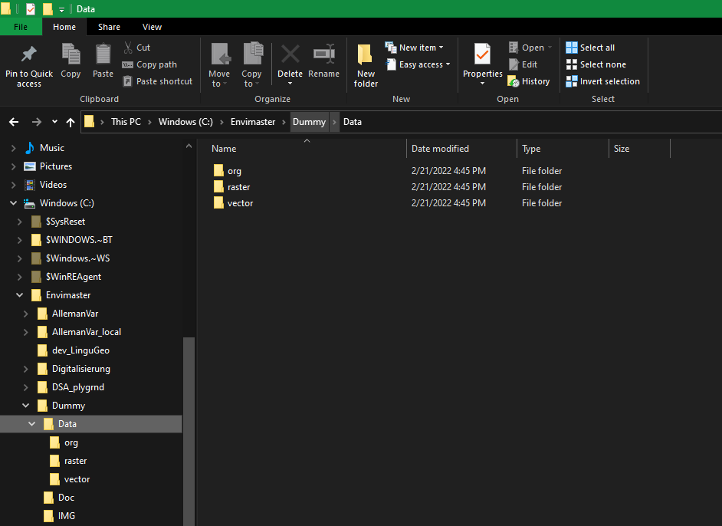
Qgis Workshop – (3) Project World Map
First Things First - Datamanagement
Short intuitive paths
Main Folder
Project Folder
Project Structur

Slide 8
Qgis Workshop – (3) Project World Map
First Things First - Datamanagement
Ordnerstruktur Methode 1
Projektordner
„Data“ - Für Daten
„Org“ - original daten
„Vector“ – Vector Daten (shp)
„Raster“ - Raster Daten (tiff)
„Img“ – Images, Output Maps
Doc/Lit/Src - Dokumente/Literatur etc
Ordnerstruktur Methode 2
„001_Data“
Vector
Org
Processed
Output
„002_Images“

Slide 9
Qgis Workshop – (3) Project World Map
First Things First - Datamanagement
Desktop, Dokumente und andere Windows Schnellzugriffe vermeiden !
Einfache und intuitive Ordnerstruktur und Namen verwenden
Struktur und Tiefe abhängig von Projektumfang und Ziel
Schreibweisen variable – „org“, „ORG“, „VEC“,“vec“,“Vec“
Lässt sich für eineindeutige Bezeichnungen in Unterordner verwenden
zB Data/VEC/ Data/ORG/vec
Für Online Cloud oder Versionsmanagement Systeme empfielt sich ein separater Daten Ordner (local)

Slide 10
Qgis Workshop – (3) Project World Map
First Things First - Datamanagement
Assignment
Prepare your Folder Structure for our WorldMap Project
Create a Main Folder on a local Drive (eg „C:/)
Create Subfolders for „Data“ and “IMG“
For „Data“ create Subfolders for „org“, “vector“ and „raster“
As well as an „output“ folder
IMG
DATA
Org
Vector
Raster
Output

Slide 11
Qgis Workshop – (3) Project World Map
Get your Data – and the world is yours
Typical Data Sources
Natural Earth
simple worldwide vector and raster datasets
Perfect for World Scale and simple overview maps
https://www.naturalearthdata.com/
Open Street Map
big worldwide vector datasets
Perfect for mid to great scale (EU/D/City)
https://download.geofabrik.de/
Satellite Data
big worldwide raster datasets
Most likely NOT usable for our interest
Usable for high resolution DEM/DSM for Backgrounds
https://earthexplorer.usgs.gov/

Slide 12
Qgis Workshop – (3) Project World Map
Get your Data – and the world is yours
Assignment
Get Data for our WorldMap Project
Go to https://www.naturalearthdata.com/
And download the following datasets
Raster, great scale: „Ocean Bottom“ and „Shaded Relief“
Vector (physical),great scale: „Rivers“
Vector (cultural),great scale: „Admin-0 Countrys“
Unzip and save the data to their respective folders in our structure ;)

Slide 13
Qgis Workshop – (3) Project World Map
Now (finally) lets start with GIS
„On the fly“ the plane may crash
The „on the fly“ projection can be helpful for simple maps
BUT will lead to critical issues when using different or wrong projected layers
The toolbars
Plug Ins – The Power of open source GIS
Download the „QuickMapService“ plugin for access to background maps

Slide 14
Qgis Workshop – (3) Project World Map
Now (finally) lets start with GIS
Assignment
Start Qgis, load our data and visualize them
Play with symbologie settings
Vector – Field calculator (SQL) and rule-based symbols
Calculate the lenght for all rivers
Visualize only rivers with lenght > 300000
Names and Labels and Workarounds
Label the countrys
Feel free to try to rule-based label them by area
Calculate area
Get two copies of the country layer
label all layers (3) by 3 classes (eg small countrys, small font)

Slide 15
Qgis Workshop – (3) Project World Map
Some further ideas
Assignment
Use transparency and blending modes
Style Copying (and pasting)
Load a dataset (not copying) eg the country layer to our project
Copy the style for the „old“ layer and past it to the new one
Data manipulation
Delete a part of the data (eg the USA from the countrys)
Save the layer
Data manipulation and Qgis saving (Issue?)
Take a look at the saved country layer
Understand why „org“ folder is essential ;)

Slide 16
Qgis Workshop – (3) Project World Map
Maskenball und Kleider zuschneiden
Assignment
Create a „mask“ for a much smaller study area (eg the Deutsches Reich)
Clipping
Clip our data for the extent of the mask

Slide 17
Qgis Workshop – (3) Project World Map
From GIS (with love) to Print Layout
Assignment
Open a new Print Layout and add our world map
Add legend, scalebar and textfield
Play with several options
Now we could print our map (some may look nice on your office wall ;) )

Slide 18
Qgis Workshop – (3) Project World Map
What you should have learned by now
Datamanagement and folder structur
Getting, loading and visualizing data
Data manipulation and some issues with Qgis
Design and print a map

